Slide 1




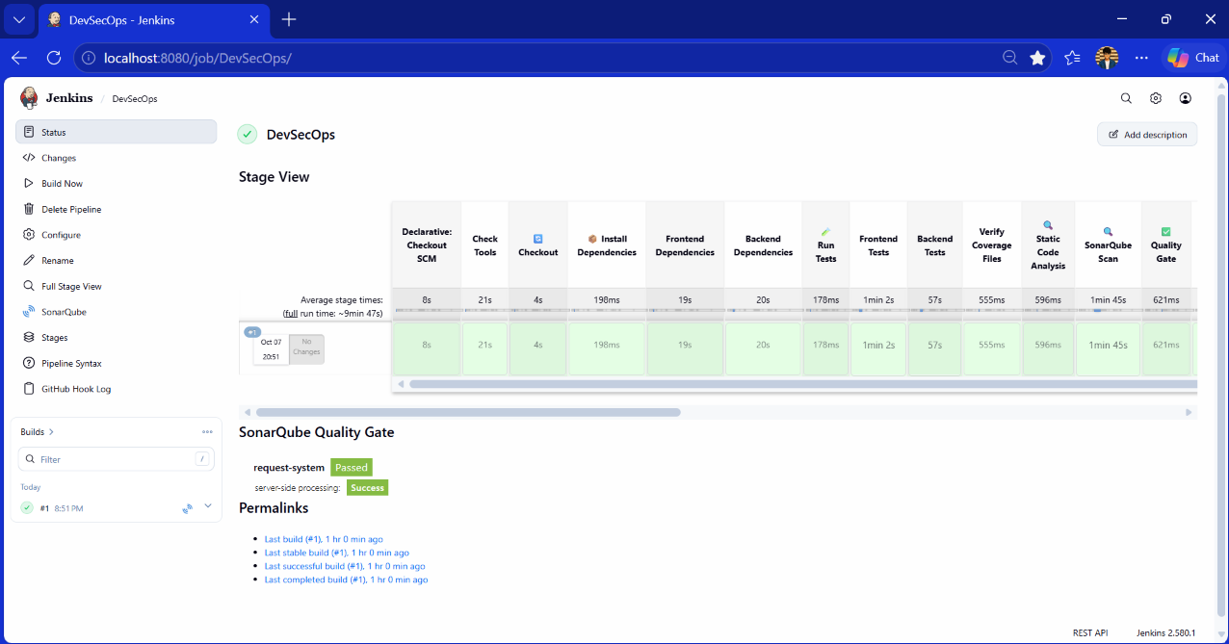
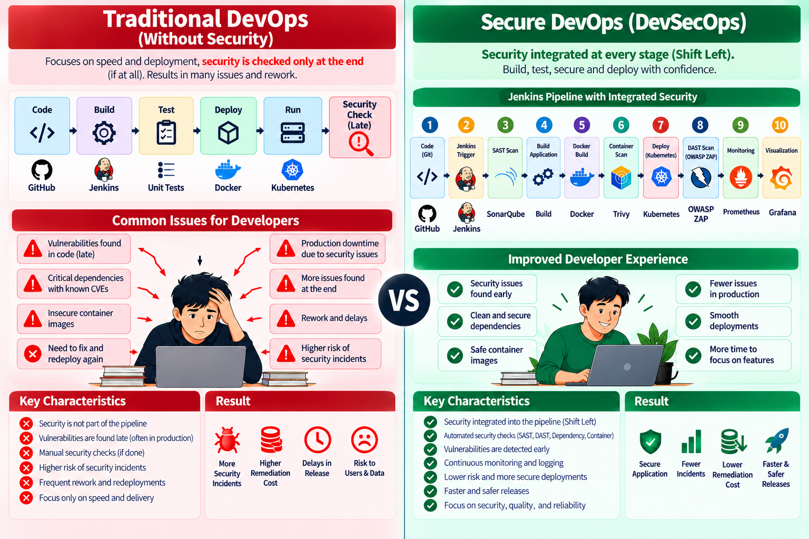
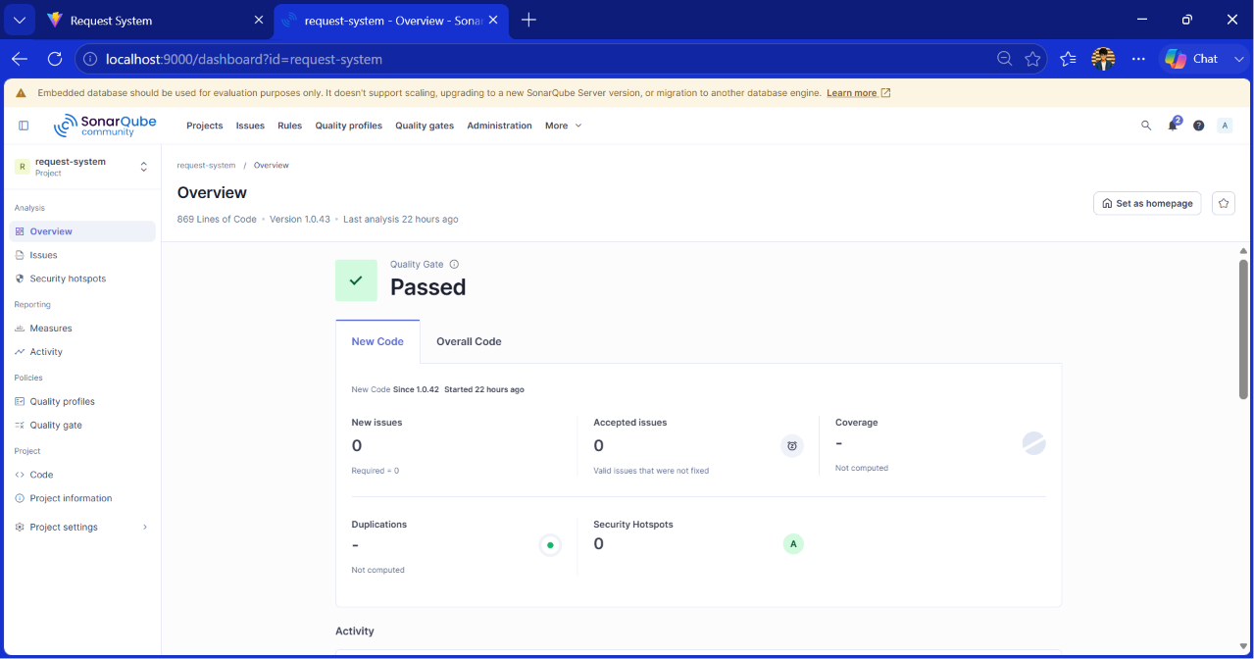
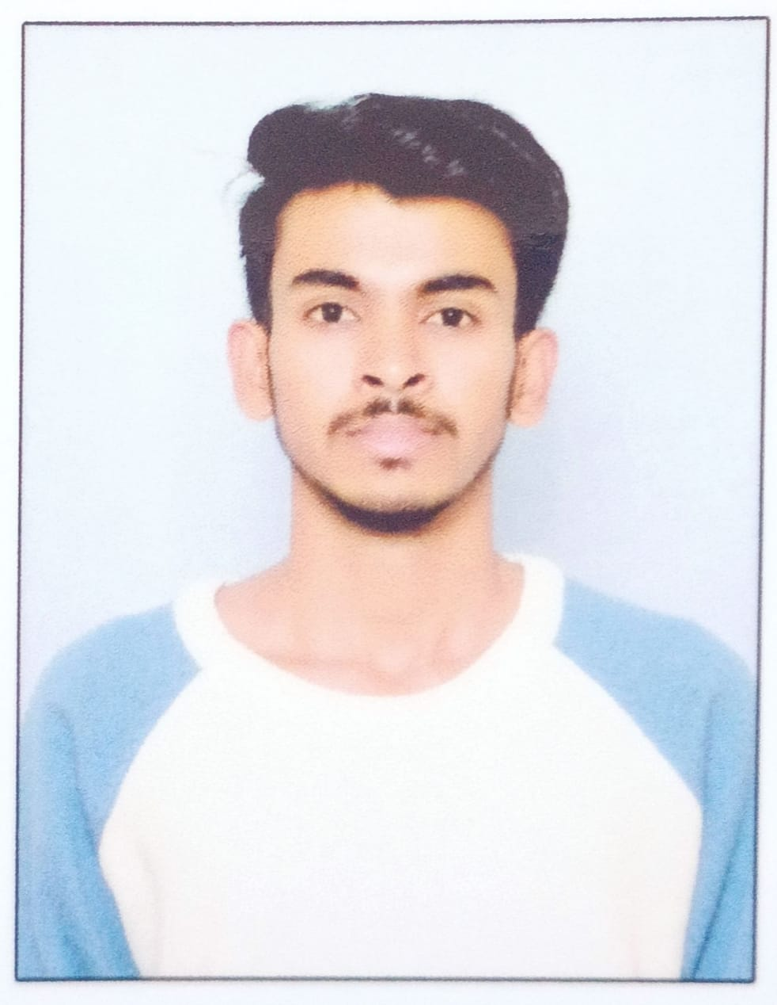
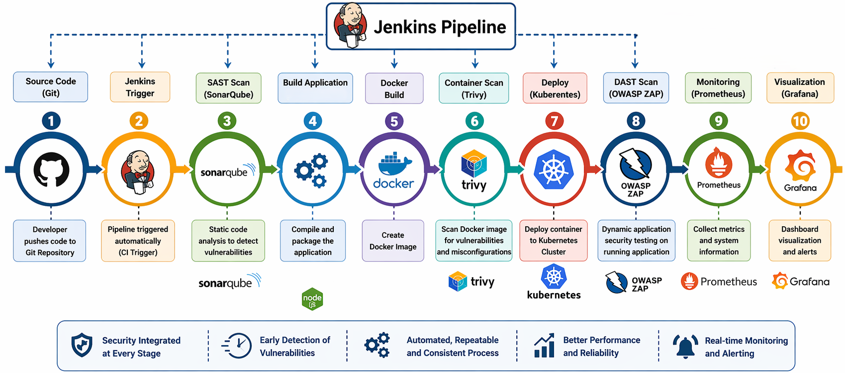
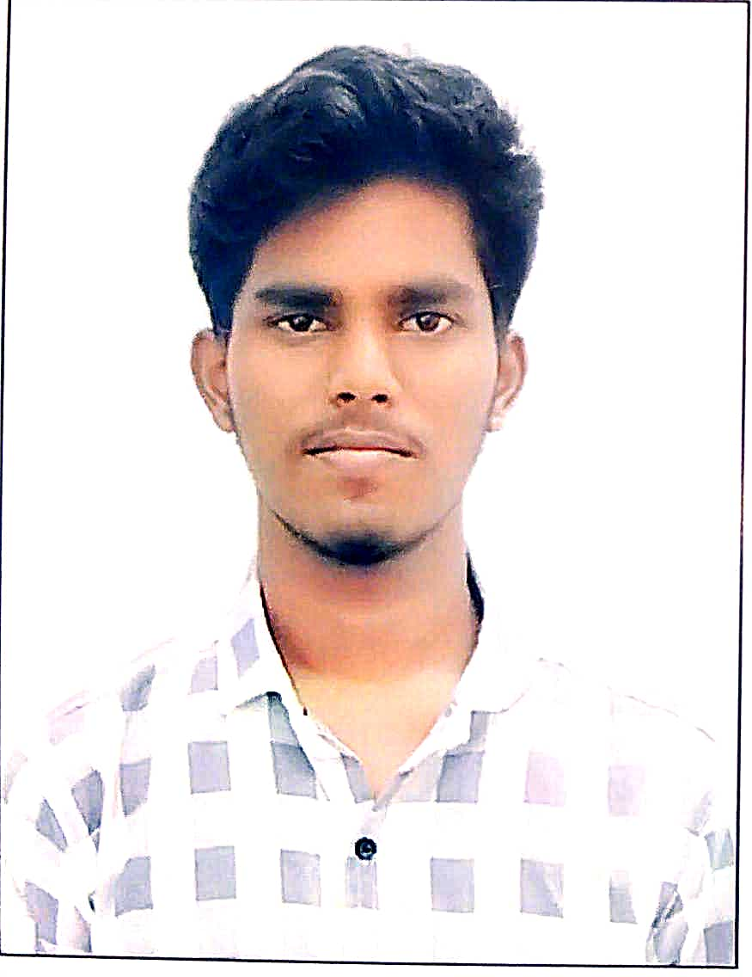
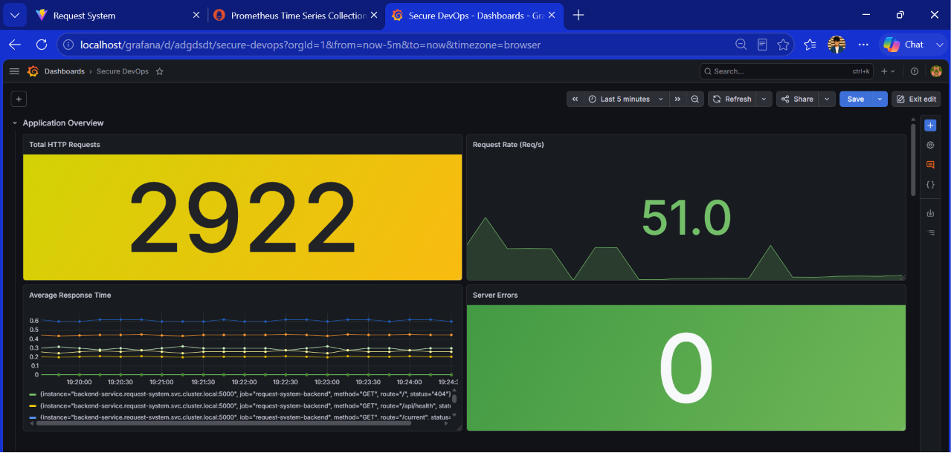
GLOBAL ACADEMY OF TECHNOLOGY
An Autonomous Institute, Approved by AICTE, New Delhi, Affiliated to VTU
Ideal Homes Township, Rajarajeshwari Nagar, Bengaluru – 560 098
SDG Logo
ANVESHANAM – 2026
A Capstone Project Exhibition
Department of Computer Science and Engineering
Secure CI/CD Pipeline with Integrated Security Testing
Innovate • Build • Showcase
Group No.: G14
OBJECTIVES
SYSTEM Overview
RESULTS
To design and implement a secure CI/CD pipeline
To integrate security testing tools into DevOps workflows
To identify and mitigate vulnerabilities at early stages of development
To reduce security risks and remediation costs
To ensure faster and secure software delivery
TRADITIONAL DEVOPS vs SECURE DEVOPS
Traditional DevOps focuses mainly on rapid development and deployment, with security checks performed late or separately. This can lead to late vulnerability detection, rework, deployment delays, and higher security risks.
Secure DevOps (DevSecOps) integrates security throughout the CI/CD pipeline using automated security checks. This enables early vulnerability detection, fewer production issues, smoother deployments, and more secure applications.
Fig 1: Jenkins DevSecOps Pipeline showing successful execution of CI/CD stages
PROJECT TEAM
 | USN | Student Name
 | 1GA23CS137 | Revanth Kumar T S
 | 1GA23CS148 | Sanket
 | 1GA23CS151 | Shakthi Vel K
 | 1GA23CS193 | Vignesh P
Photo
Photo
SYSTEM ARCHITECTURE
The system architecture represents the end-to-end Secure DevOps pipeline. A developer pushes code to GitHub, which triggers Jenkins to automate the pipeline; SonarQube performs code analysis, Docker builds the container, Trivy scans it for vulnerabilities, Kubernetes deploys the application, OWASP ZAP performs dynamic security testing, and Prometheus + Grafana provide continuous monitoring and visualization.
GitHub → Jenkins → SonarQube → Docker → Trivy → Kubernetes → OWASP ZAP → Prometheus → Grafana
Photo
Fig 2: SonarQube dashboard showing a passed Quality Gate with no new issues or security hotspots.
Photo
Role | Name
Project Guide | Prof. Sameena H S
Project Coordinator | Dr. Shruthi G
Head of Department | Dr. R Rajkumar
Academic Year: 2026–2027
Fig 3: Grafana dashboard showing application requests, response time, and server error metrics.
Notes:
<number>

